Slide 1
Computer’s Security
By Sagi Buria, Lior Nissan, Viktor Dabush, Noa Mishraki, Timor

Slide 2


Slide 3
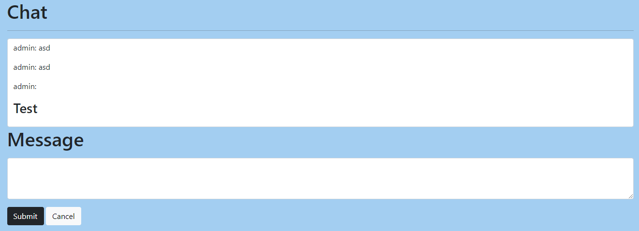
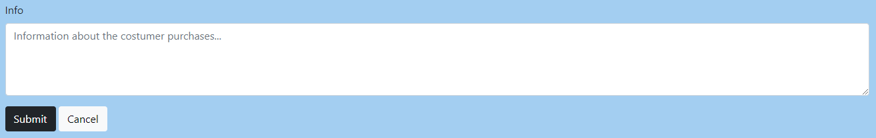
XSS Attack Vector
How does Django handle XSS?
Django templates escape specific characters which are particularly dangerous to HTML. This is done automatically on every Django template. But it can be disabled.
Our workaround
Disable the autoescape module to allow the HTML DOM to be rendered and avoid character escaping
Input example to perform an attack
<script>alert(1)</script>
This will pop an alert on the user’s browser.
This of course can be used by a malicious user to perform all kind of attacks, such as getting the
users IP addresses by sending them to a web-hook.
Image of the vulnerable field

Slide 4

SQL Injection Attack Vector
How does Django handle SQLi?
Because of the use of Django’s ORM, no raw SQL queries are used. This ORM (object-relational mapping) layer will convert the python objects to SQL queries by itself.
Our workaround
Inorder to create an input field that is vulnerable, we switched to use raw MySQL queries instead of using the ORM. We didn’t restrict any special characters of escaped them.
Input example to perform an attack
To get all the customers out of the system, a user can input the following: “% -- “, this will create the following query in the server side: "SELECT * FROM webapp_costumer WHERE name LIKE '%% -- %' AND sales_person_id = {current_user.id};"
Because of the “-- ” characters, the second statement of will be commented out, which will create an SQL vulnerability
Image of the vulnerable field
Source- https://docs.djangoproject.com/en/4.0/topics/security/

Slide 5
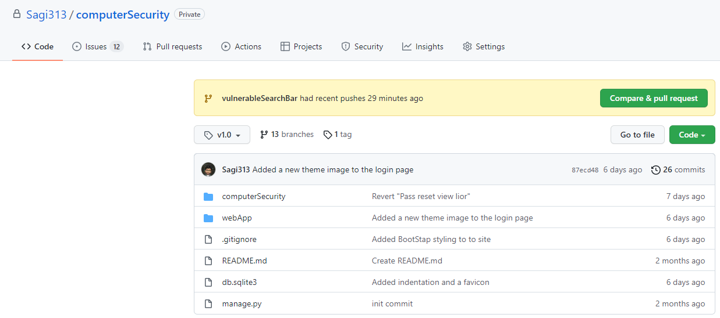
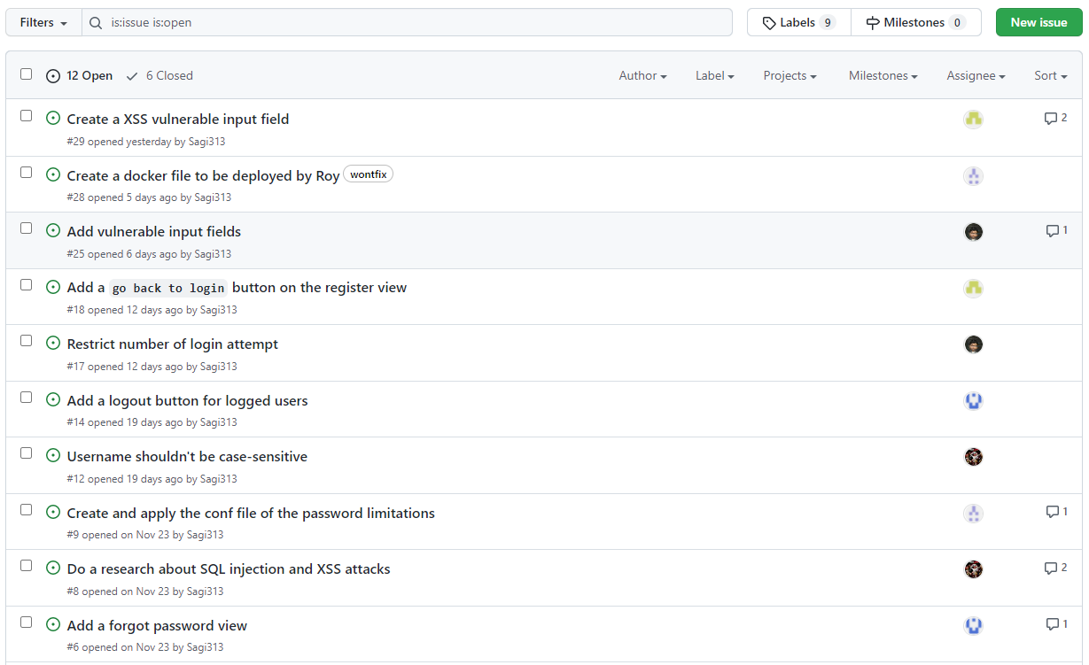
Workflow
To keep track of assignments, we managed the project using GitHub. Each one got his own tickets and worked on his own feature branch. On each weekly meeting we reviewed the changes and merged the branches to the tag
Github pics

Slide 6
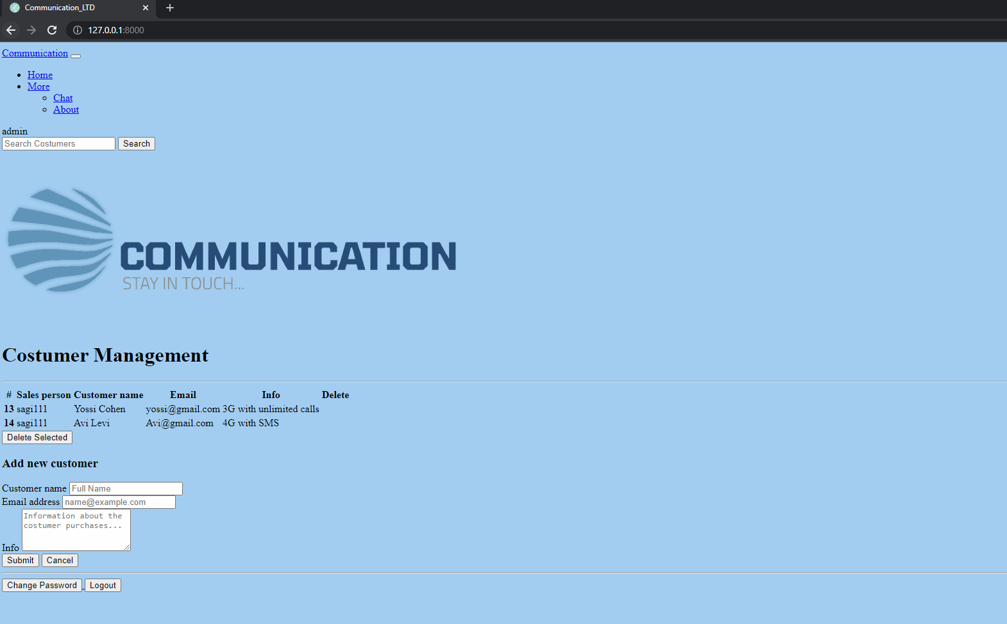
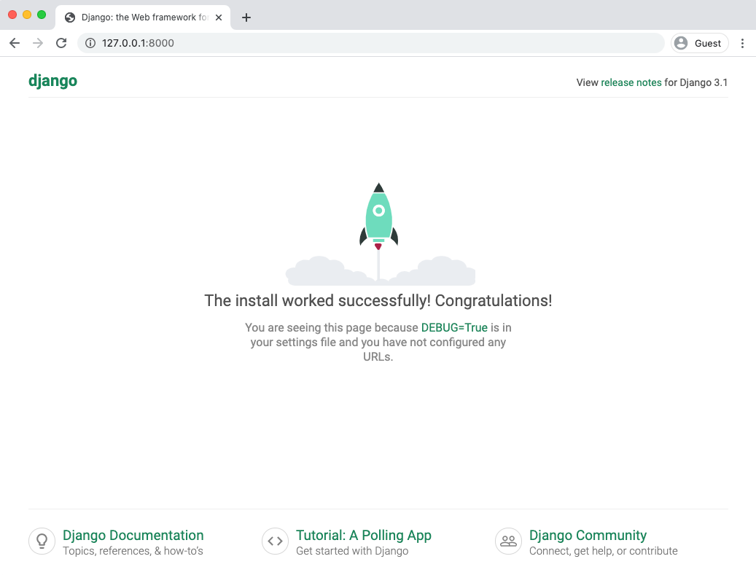
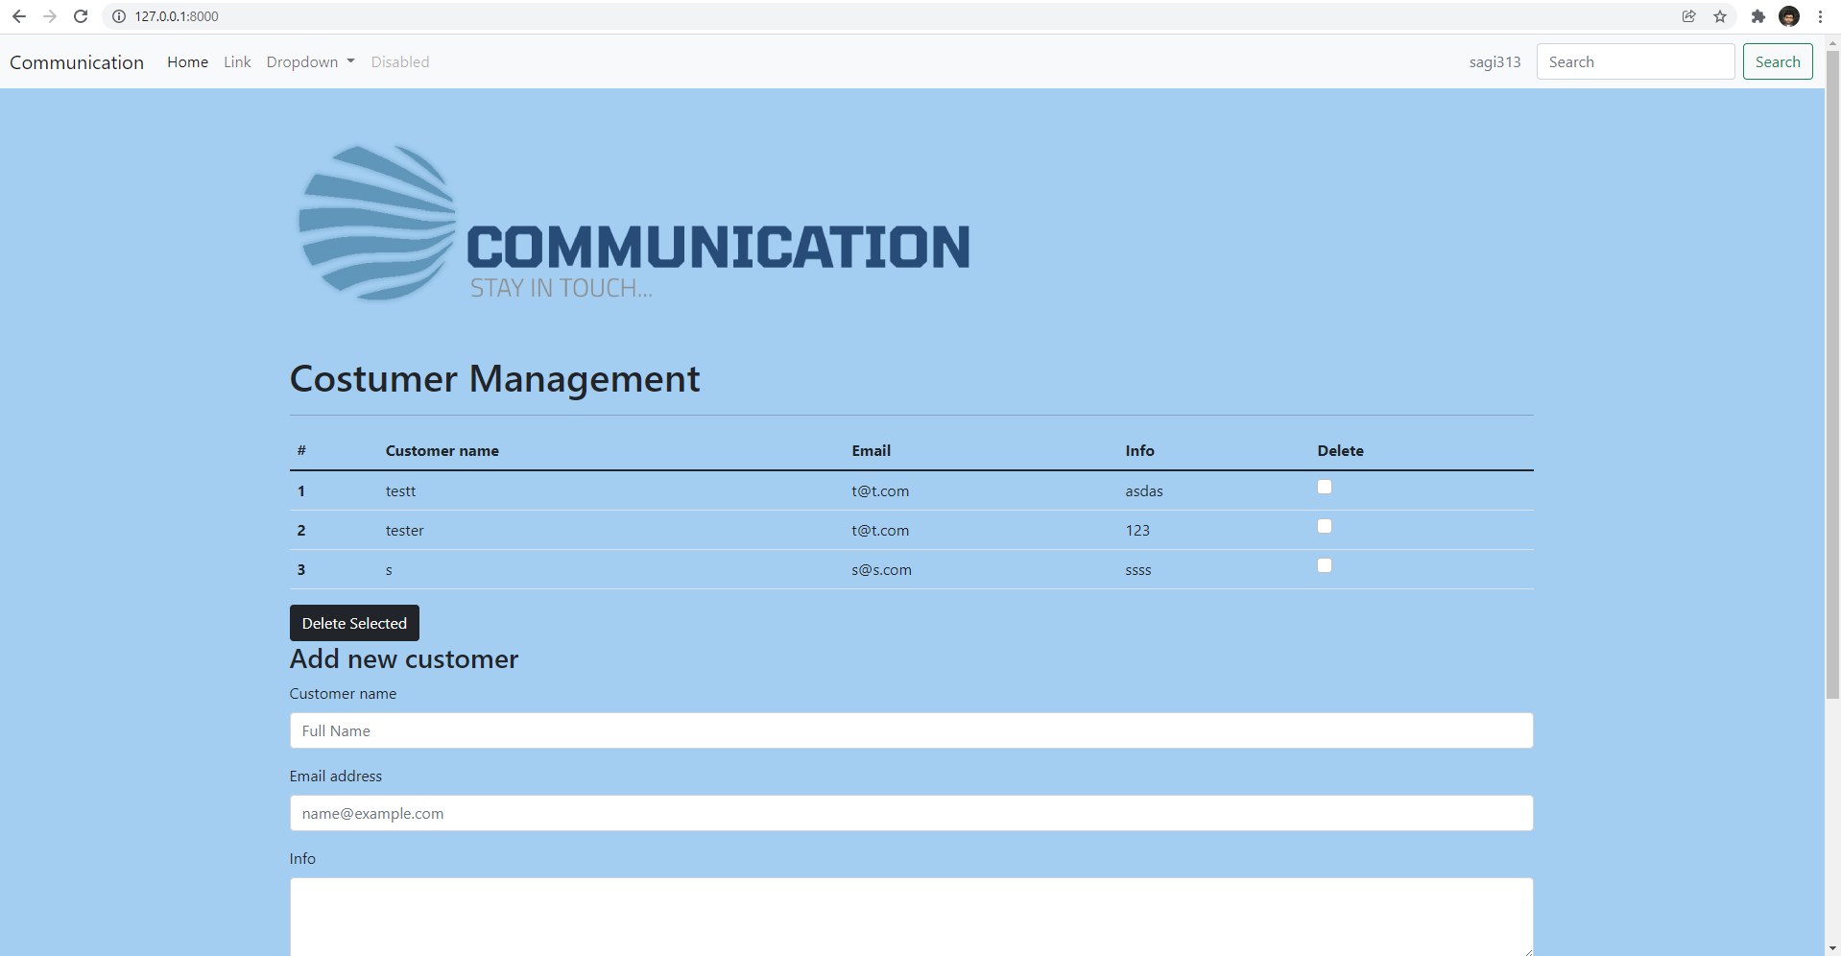
Design Flow

Slide 7
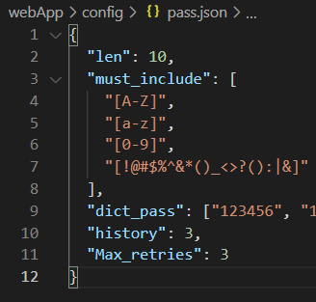
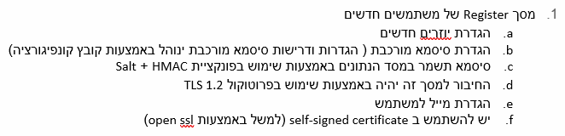
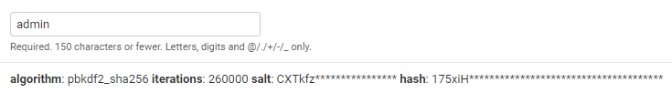
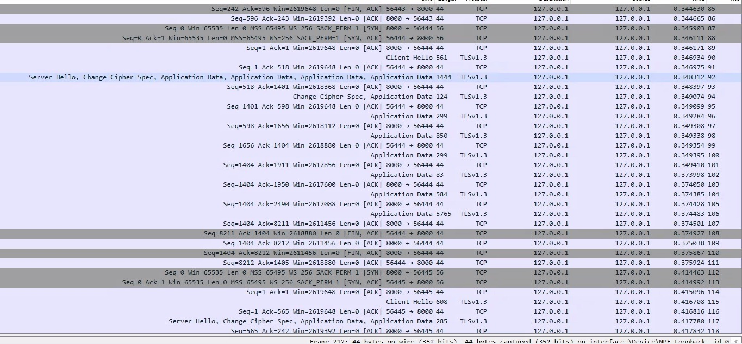
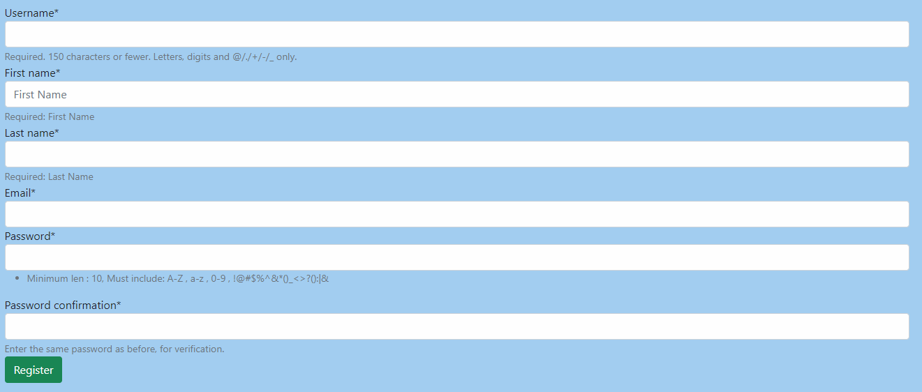
Project Requirements Part A
b.
c.
D + f
a.
e.

Slide 8
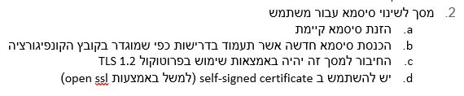
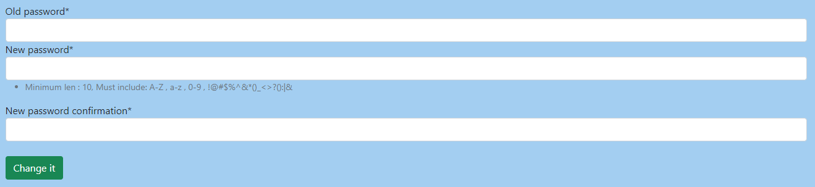
Project Requirements Part A
a.
b.
b.
c + d
To run using TLS, use the following command:
“python manage.py runserver_plus --cert-file cert.pem --key-file key.pem”

Slide 9
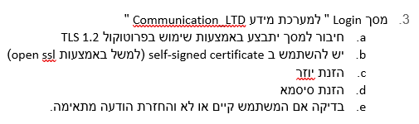
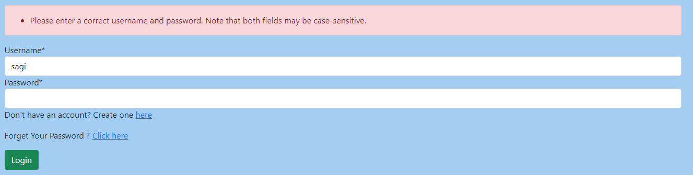
Project Requirements Part A
e.
c.
d.

Slide 10

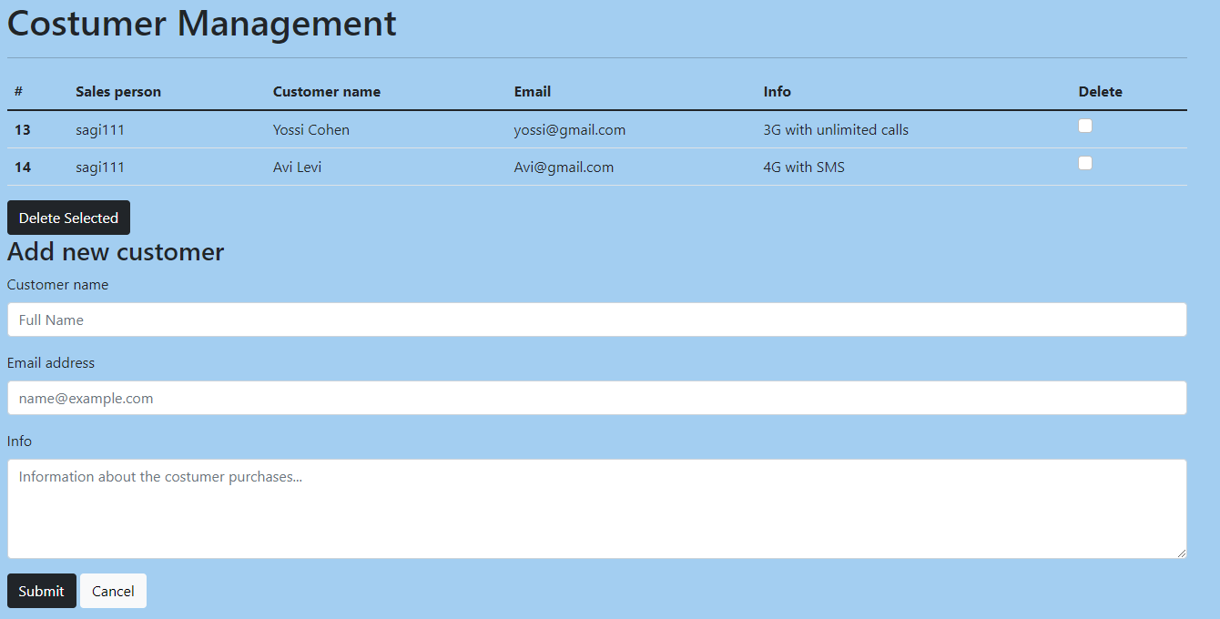
Project Requirements Part A
b.
a.

Slide 11
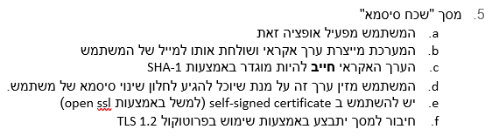
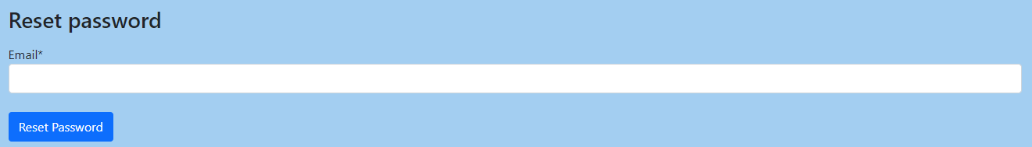
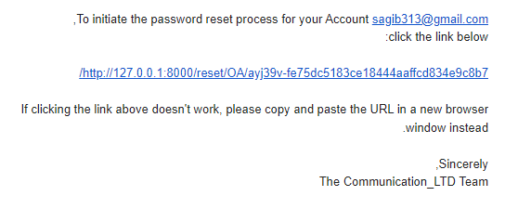
Project Requirements Part A
a.
b + c +d
* An approval was given to use a link instead of a code

Slide 12
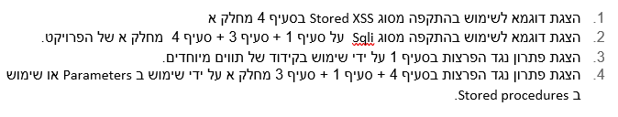
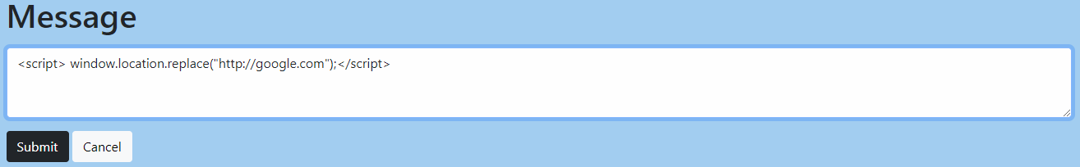
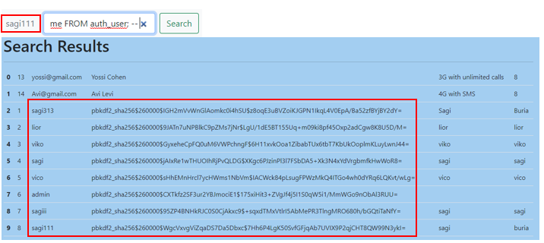
Project Requirements Part B
1.
An approval was given to use a search field that is access able from the view
2.

Slide 13
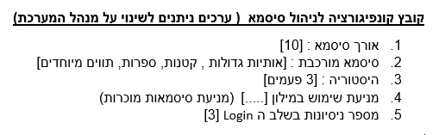
Project Requirements Part B
The password dictionary we have used is the popular RockYou file with millions of real user’s passwords

Slide 14
THANK YOU
Insert the Subtitle of Your Presentation

